Slide 1
Multi-robot Path Planning in Automated Storage System
LUO Yuanfu ∙ LI Guodong
Nov. 2014

Slide 2
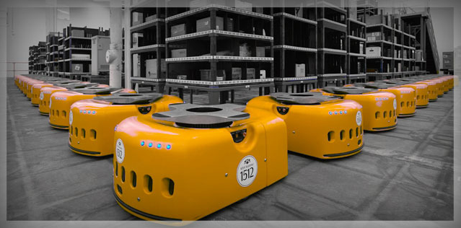
Motivation
Kiva

Slide 3
Our work
Path planning for multi-agent
find collision-free paths for every robot
ensure low runtime and high success rate
reasonable quality of the solution
Algorithm：MA-RRT*[1]
[1]M. Cáp, P. Novák, J. Vokrínek, and M. Pechoucek, "Multi-agent RRT*: Sampling-based Cooperative Pathfinding (Extended Abstract)", ;presented at CoRR, 2013.

Slide 4
Algorithm Description
algorithm we use: Multi-agent RRT* (MA-RRT*)
MA-RRT* is based on RRT*
RRT* is based on RRT
RRT: Rapidly-Exploring Random Tree

Slide 5
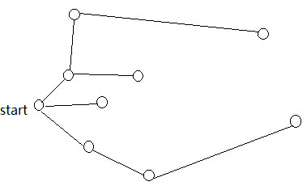
RRT*

Slide 6
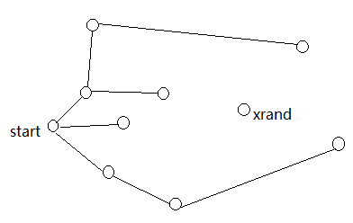
RRT*

Slide 7
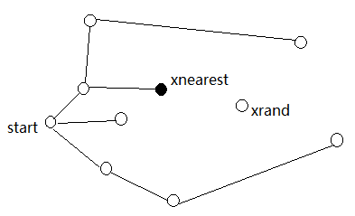
RRT*

Slide 8
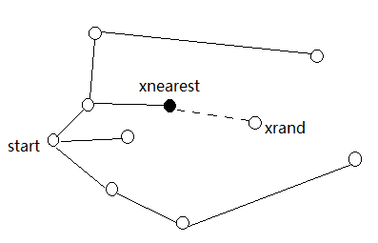
RRT*
Greedy Extension
greedy extension

Slide 9
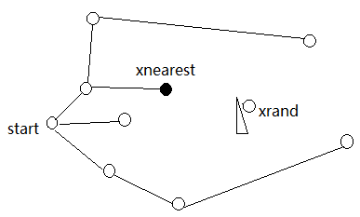
RRT*
can not always reach to xrand

Slide 10
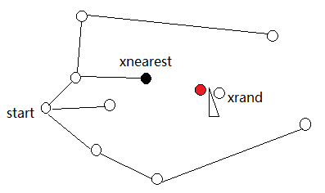
RRT*

Slide 11
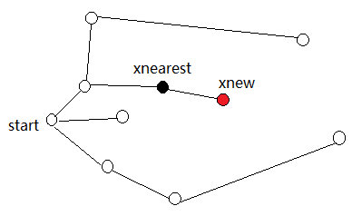
RRT*

Slide 12
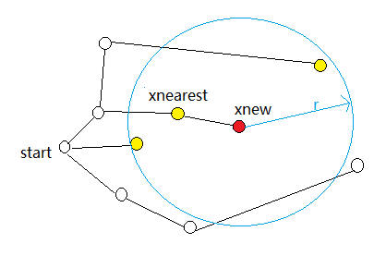
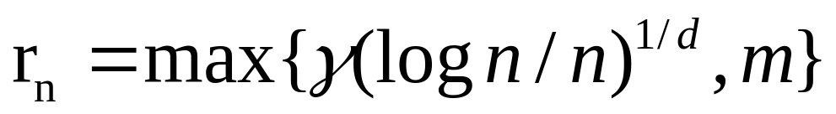
RRT*

Slide 13
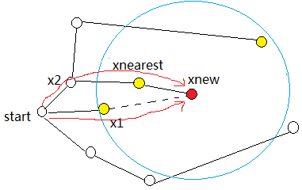
RRT*
if the robot can go from x1 to xnew
cost(start->x1->xnew) < cost(start->x2->xnearest->xnew)

Slide 14
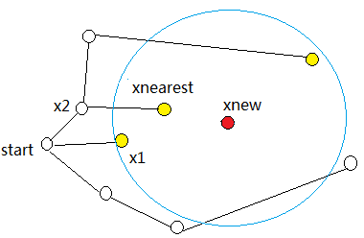
RRT*
delete the edge <xnearest, xnew>

Slide 15
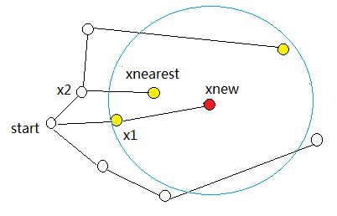
RRT*
make x1 as the new father of xnew

Slide 16
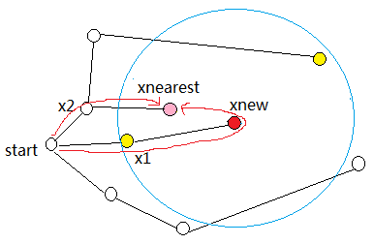
RRT*
check every node in the ball except xnew's father node, to see whether we can reduce the cost by going through xnew
can xnew reach xnearest?
cost (start-> x1-> xnew-> xnearest) < cost (start->x2-> xnearest) ?
No! go on to check node.

Slide 17
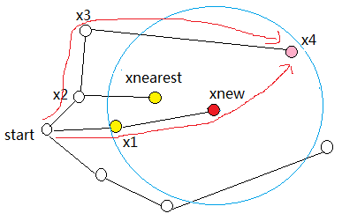
RRT*
can xnew reach xnearest? --Yes
cost (start-> x1 -> xnew -> x4) < cost (start-> x2 -> x3 -> x4) ?
-- Yes! Change the parent of x4

Slide 18
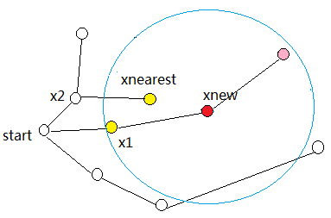
RRT*

Slide 19
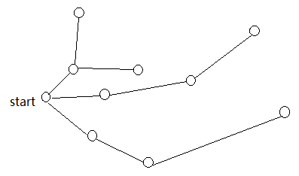
RRT*
A new tree

Slide 20
Multi-agent RRT*
The formulation of the algorithm is identical to RRT*, execept that the algorithm performs the search in the agents’ joint-state space

Slide 21
Multi-agent RRT*
modifications:
state space becomes n-tuples (w₁,w₂,...,w_{N}), w_{i} is the way point occupied by agent i
all motion primitives have the same duration
when the target is reached, the agents wait for the longest traveling agent
n-tuple of action is checked for possible separation breach between the agents

Slide 22
Implement
OMPL [2]
ROS [3]
[2]The Open Motion PlanningLibrary http://ompl.kavrakilab.org/
[3] Robot Operating System http://wiki.ros.org/

Slide 23
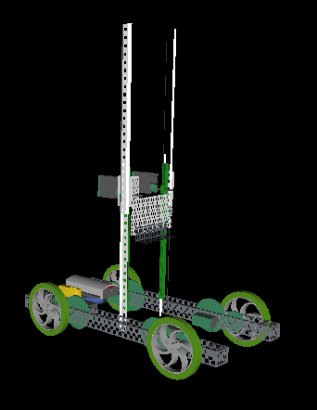
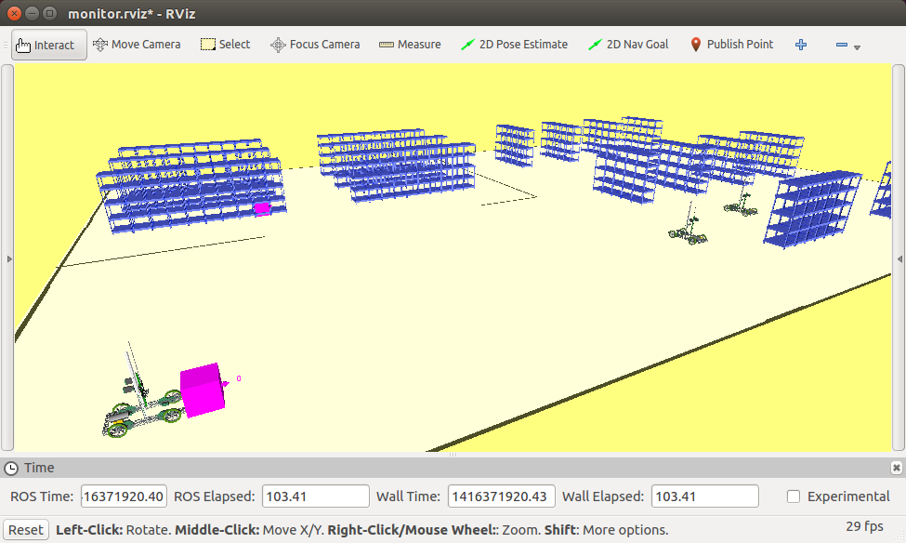
Experiment
simulator

Slide 24
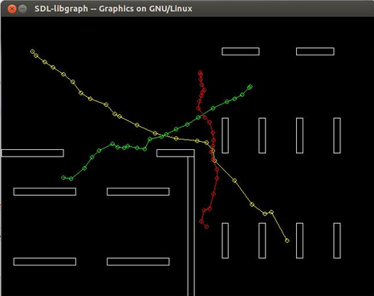

Slide 25
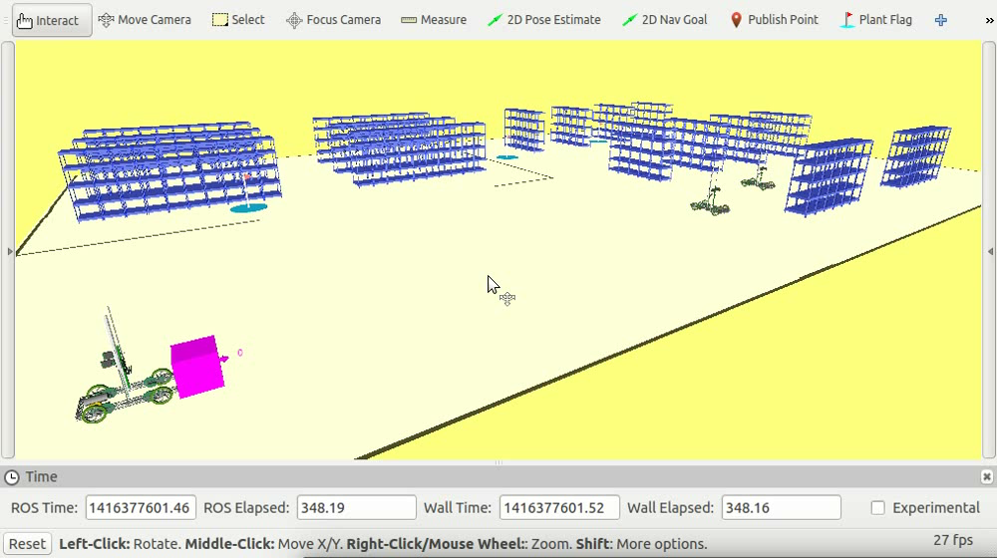
Result
Video clip

Slide 26
Conclusion
In this work, we implemented a MA-RRT* , which exploits the sampling-based motion planning and searches for a solution in agents’ joint-state space using randomized sampling.
Future work:
consider uncertainty
task scheduling part

Slide 27
Thank you!
Q&A

